Slide 1
Research Methodology
Advised by:
Dr. Safiullah Faizullah
Group members:
Ahmed Saleh (362047783)
Ahmed AL-Abboud (361010783)
Mohammed Jamal (362049583)

Slide 2
Introduction
With two thirds of the earth's surface covered by water and the human body consisting of 75 percent of it, it is evidently clear that water whether groundwater, rainwater or otherwise, is the secret of life on earth.
Given the limited nature of these sources, water is a source of strength and a major force in people's lives.
Agriculture plays an essential role in the economic and social development in the world.

Slide 3
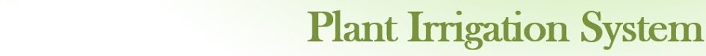
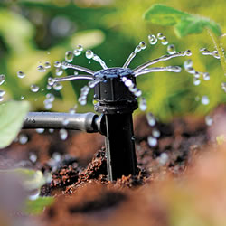
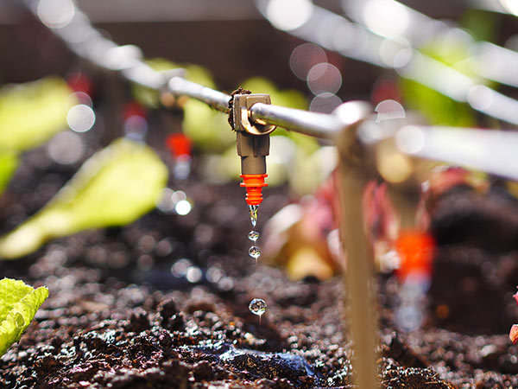
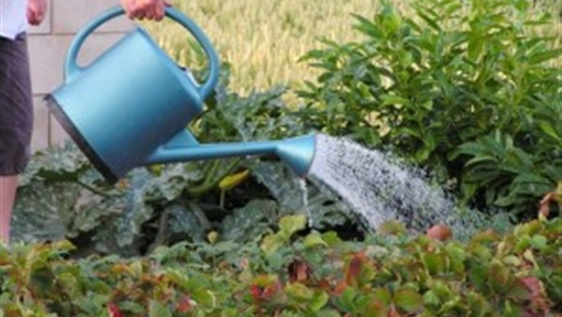
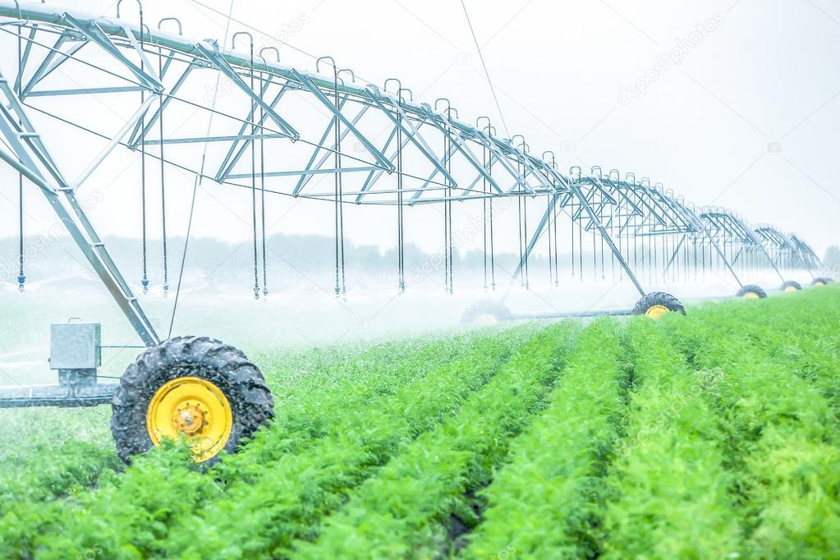
Irrigation is the replacement or supplementation of rainwater with another source of water.

Slide 4
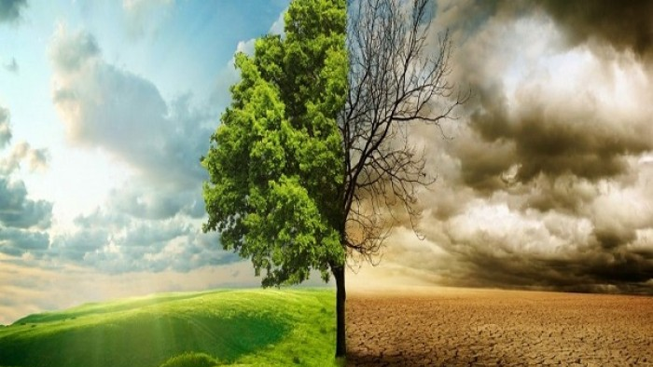
Problem statement
1- Most irrigation systems are used in an inefficient way.
2- There are problems with the consumption of a large amount of water in traditional irrigation.
3- May cause damage to plants and make them dead.

Slide 5


Aim
Building an application and utilize sensors that helps farmers to irrigate their plants in an easy and economical way.

Slide 6

Objectives
Building an application.
Use sensors to measure the water temperature, soil moisture and weather temperature .
Source of water(water tank).
Connect the sensor to the application.
Connect the open and close water process to the application.

Slide 7

Arguments
There are some important arguments which most people mentioned for plant irrigation system :
Preserving water through irrigation in a modern and organized manner.
The rate of water added can be controlled. and distribution of water regularly
Reduce the costs required for irrigation in the traditional way.

Slide 8

Methods
1- Literature Analysis
2- Questionnaires

Slide 9
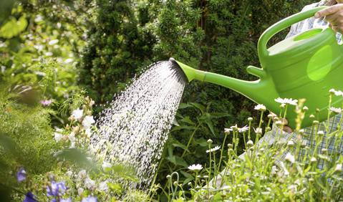
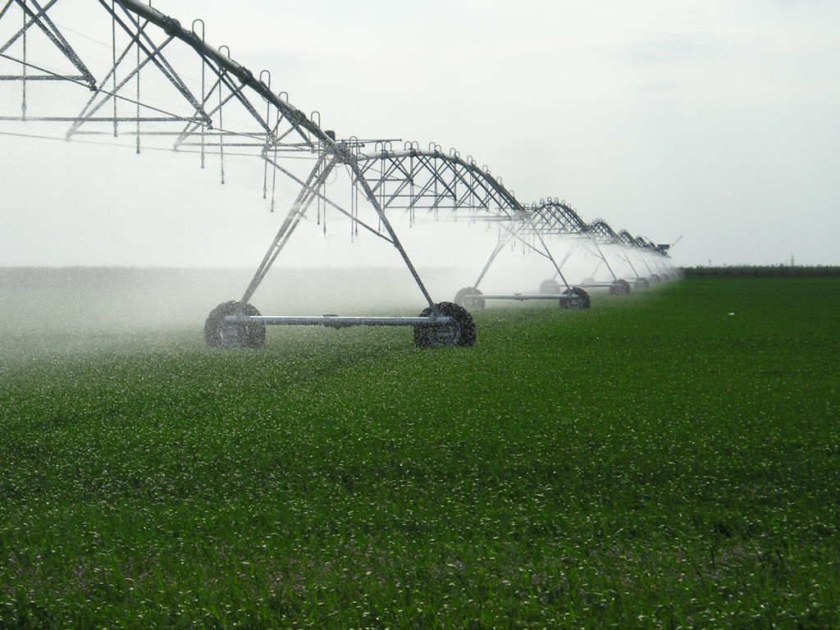
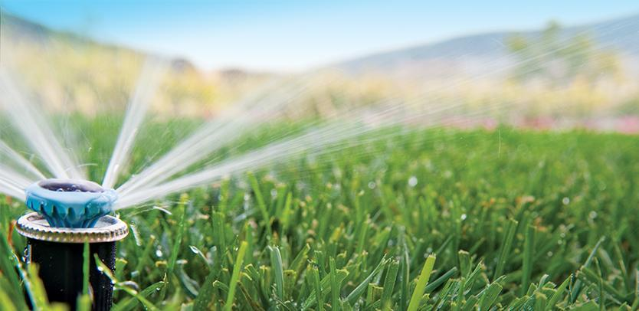
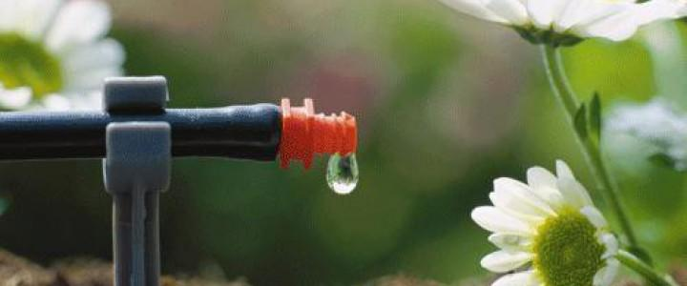
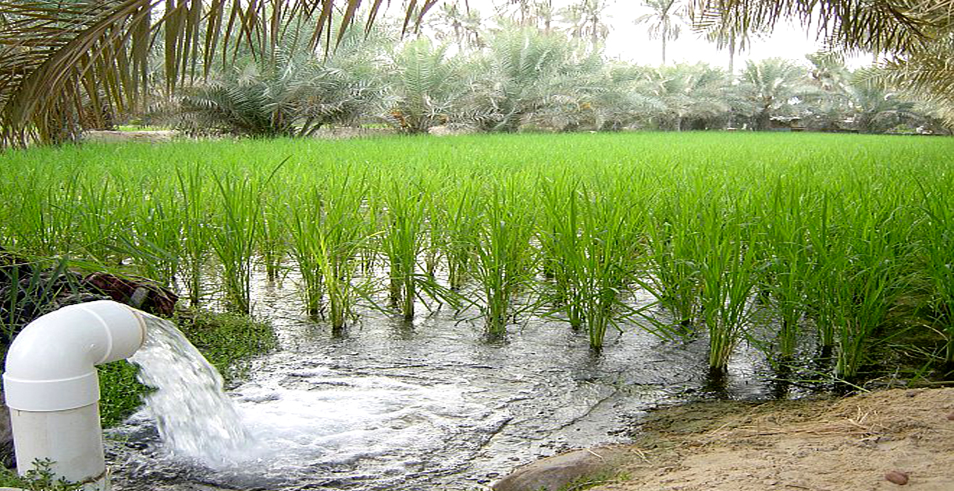
Literature review
The traditional methods that are used for irrigation, such as rotary watering , mighty dripper, flood type and using a jug or a bucket is not that much efficient.
Many irrigation systems are a stupid device connected to the water source and controlled manually.

Slide 10

Literature review
( mighty dripper watering system )
1 - The possibility of clogging the dumps with dirt and algae.
2 - Possibility to be damaged by rodents.
( Rotary watering system )
1 - Rotary irrigation system requires a constant water source.
2 - Needs a land of regular form.

Slide 11
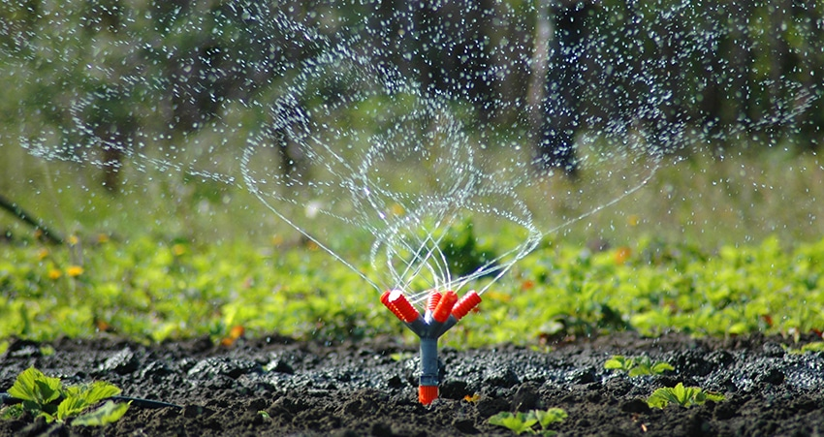
Thank You
MEMO

